Slide 1
Nafion SCFT Update
10/01/2024

Slide 2
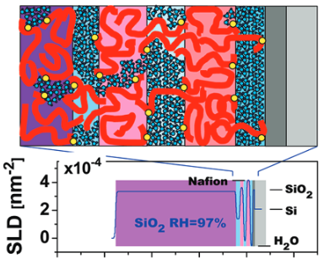
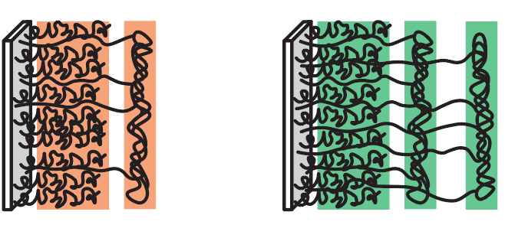
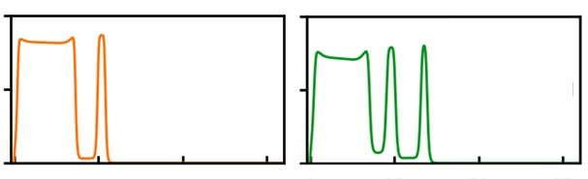
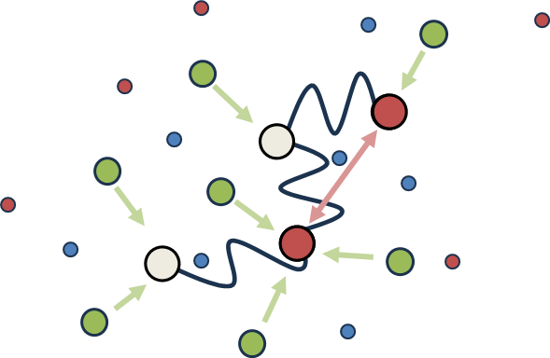
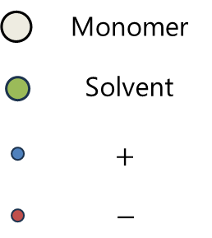
Last time: Motivation
Polymer morphology is important (but complicated) in nafion membranes
Experiment
Theory
Self-consistent field theory (SCFT) can provide nafion microstructure under coupled physics
Elasticity vs. charge vs. hydrophobicity

Slide 3
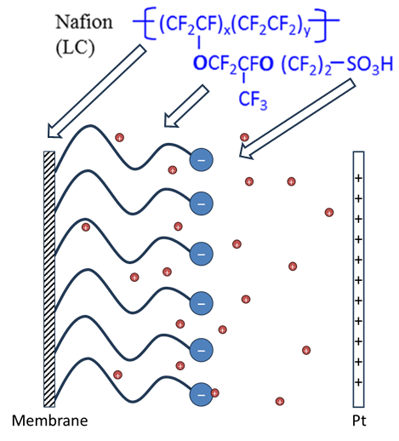
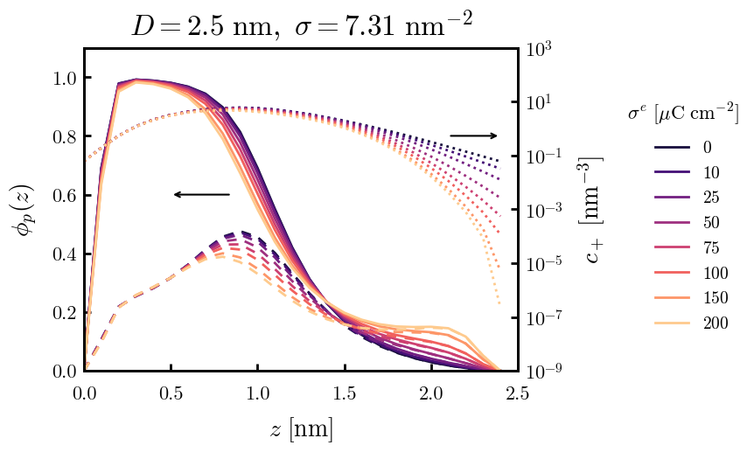
Last time: Model
Subvolume: Water-rich layer adj. to electrode
Polymer: Nafion sidechains only
Solvent: Explicit, water
Ions: Salt solution
Charged species: Surface (+/−), sidechain sulfonates (−), salt cation (+), salt anion (−)
Takeaways
As surface charge becomes more positive, distribution of sulfonates shifts
Proton concentration not as affected (see next slide)

Slide 4
This time: Model
Subvolume: Bulk PEM + water-rich layer
Polymer: Const. PEM density + sidechains
Solvent: Explicit, water
Ions: Sulfonate counterions
Charged species: Surface (+/−), sidechain sulfonates (−), counterion (+)
Reasons
Additional bulk region needed to properly resolve proton distribution
Humidity affects water layer thickness

Slide 5
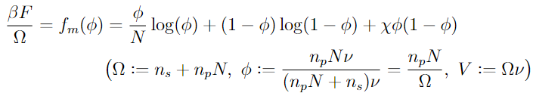

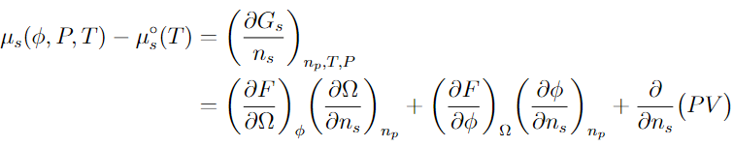
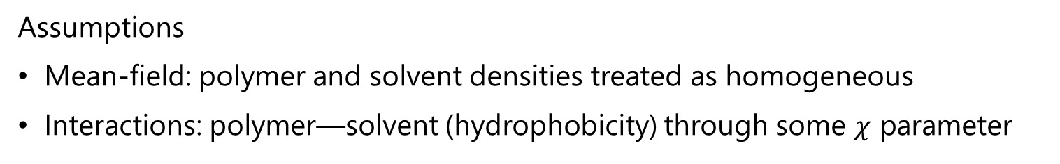
Bulk PEM – Flory-Huggins MFT
Assumptions
Mean-field: polymer and solvent densities treated as homogeneous
Interactions: polymer—solvent (hydrophobicity) through some $χ$ parameter
Building blocks
F-H Helmholtz free energy
(lattice version here, but can be generalized to MF)
Gibbs free energy
Solvent chemical potential

Slide 6
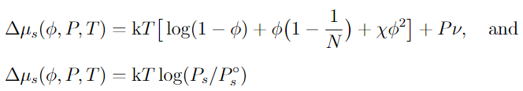
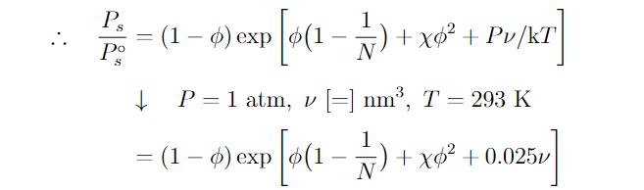
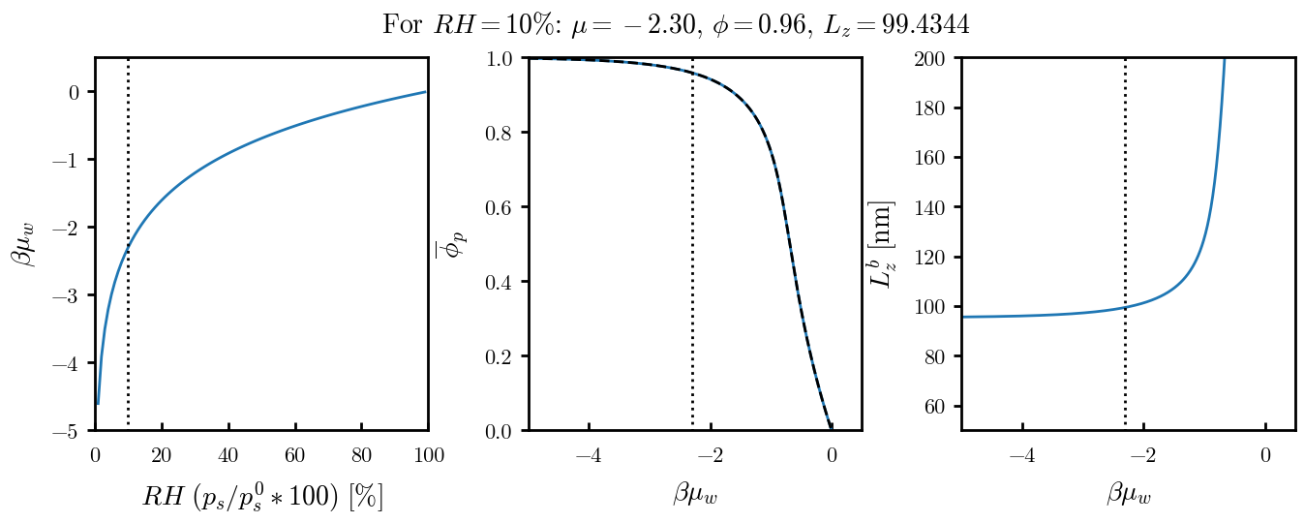
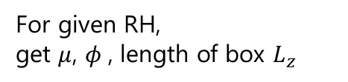
Bulk PEM – Flory-Huggins MFT
Final equations
For given RH, get $μ$, $φ$, length of box $L_{z}$

Slide 7
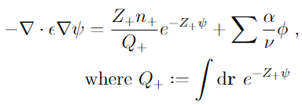
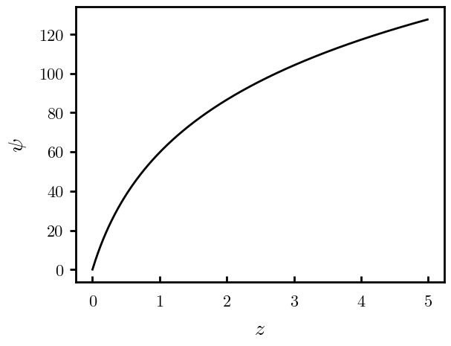
Poisson—Boltzmann Counterions
Analytical solution (surface charge positive, counterion only)
Key features
Log-divergence
Sharp at surface

Slide 8
Numerical approaches

Slide 9
Supplemental Slides

Slide 10
test

